Slide 1
IBM University Engagement Project Submission
“Exploring the Power of Agentic AI with IBM Granite and IBM Bob”

Slide 2

Project Tile – Sequential Task Agent – Investment Analyst
Domain of Project – [ like Agriculture / Education / Healthcare / … ]
Student Name | Recent Passport Photo | Email ID | Mobile number [WhatsApp]
Bharti Sahu |  | sahubharti1430@gmail.com | 9359327368
Recommended font style and size:
Font Style: Arial
Font Size (Heading): 28
Font Size (Content): 20

Slide 3
Problem Statement -
Problem Statement : Sequential Task Agent – Investment Analyst
The Challenge
Investment analysts need to process multiple layers of information—financial reports, stock performance data, market news, and analyst opinions. Much of this information is fragmented and requires a sequence of tasks (data gathering, validation, analysis, comparison, and reporting) to generate useful insights. Manual workflows are time-consuming and prone to errors. The challenge is not just to collect market data but to automate sequential tasks that lead to actionable investment recommendations.
The Objective
Build a Sequential Task Agent that acts as an intelligent investment analyst. The solution should:
1. Automate Data Gathering: Collect financial data from multiple trusted sources such as company reports, stock exchanges, and market news feeds.
2. Perform Multi-Step Analysis: Sequentially process data (e.g., extract KPIs → calculate financial ratios → benchmark against competitors → analyze market sentiment).
3. Generate Predictive Insights: Identify trends, detect risks, and provide forward-looking recommendations (e.g., “Stock X shows declining margins—consider underweighting in portfolio”).
4. Deliver Structured Reports: Provide an easy-to-understand dashboard with investment summaries, trend charts, risk indicators, and AI-generated recommendations.
Tech Stack (Mandatory)
• IBM Bob + IBM Cloud + IBM Granite .

Slide 4
Proposed Solution -
Proposed Solution: AI-Powered Sequential Task Agent – Investment Analyst
The proposed solution is to develop an AI-powered Sequential Task Agent using IBM Bob, IBM Cloud, and IBM Granite LLM that automates the investment research and analysis process. The system collects financial information from multiple sources, validates the collected data, performs sequential financial analysis, identifies market risks, and generates evidence-based investment insights through an interactive dashboard.
Key Innovation of the Proposed Solution
The main innovation is the integration of Sequential Task Automation + Multi-Agent AI + IBM Granite LLM into a single investment research workflow.
Unlike a conventional financial chatbot that simply answers questions, the proposed system executes a complete sequence:
Collect → Validate → Extract → Calculate → Compare → Analyze → Predict → Recommend → Report
This makes the application an intelligent investment research assistant rather than just a financial information retrieval system.
Expected Outcomes
Reduced manual effort in investment research and financial analysis.
Automated sequential processing of fragmented financial information.
Improved consistency and accuracy through data validation.
Faster identification of financial risks and market trends.
Intelligent competitor benchmarking and performance comparison.
Explainable, evidence-based investment research reports.
An integrated AI-powered investment decision-support platform.

Slide 5
Proposed Solution -
Technology Implementation
Technology | Proposed application
IBM Bob | Development, debugging and testing
IBM Cloud | Hosting, deployment and cloud services
IBM Granite LLM | Financial document understanding and AI reasoning
Python | Sequential agent execution and financial calculations
Streamlit | Interactive dashboard
Pandas, NumPy | Data processing and financial calculations
Plotly | Financial visualization
XGBoost / LSTM | Predictive analytics
Financial APIs | Market and company data collection

Slide 6
Proposed Solution -
Explainable and Responsible AI
Display the sources used for financial analysis.
Distinguish actual financial figures from AI-generated interpretations.
Validate all numerical calculations using Python.
Prevent unsupported investment recommendations.
Protect user information and API credentials.
Include risk disclosures and human review before investment decisions.
AI-Powered Financial Analysis Using IBM Granite
Integrate IBM Granite LLM for understanding financial reports and market-related information.
Extract important financial information from unstructured documents.
Summarize company performance and financial announcements.
Analyze positive, negative, and neutral market sentiment.
Generate natural-language explanations of financial performance.
Provide evidence-based investment research insights.

Slide 7
Technology Used
IBM Bob platform -For designing and orchestrating multi-agent workflows visually
IBM Grainte model - for eg – ibm-granite-3-2-8b – For natural language understanding, reasoning, and personalization
IBM Cloud – It provides the infrastructure to build, deploy, and scale the Nutrition Agent efficiently. IBM Cloud enables a reliable, secure, and scalable environment for deploying the Nutrition Agent.
RAG– RAG to fetch real data first, then generate intelligent answers, making the Nutrition Agent more trustworthy and effective.
IBM Watsonx.ai - For model deployment, embeddings, and AI governance
Vector Database (FAISS/Chroma) – For RAG-based nutritional data retrieval

Slide 8
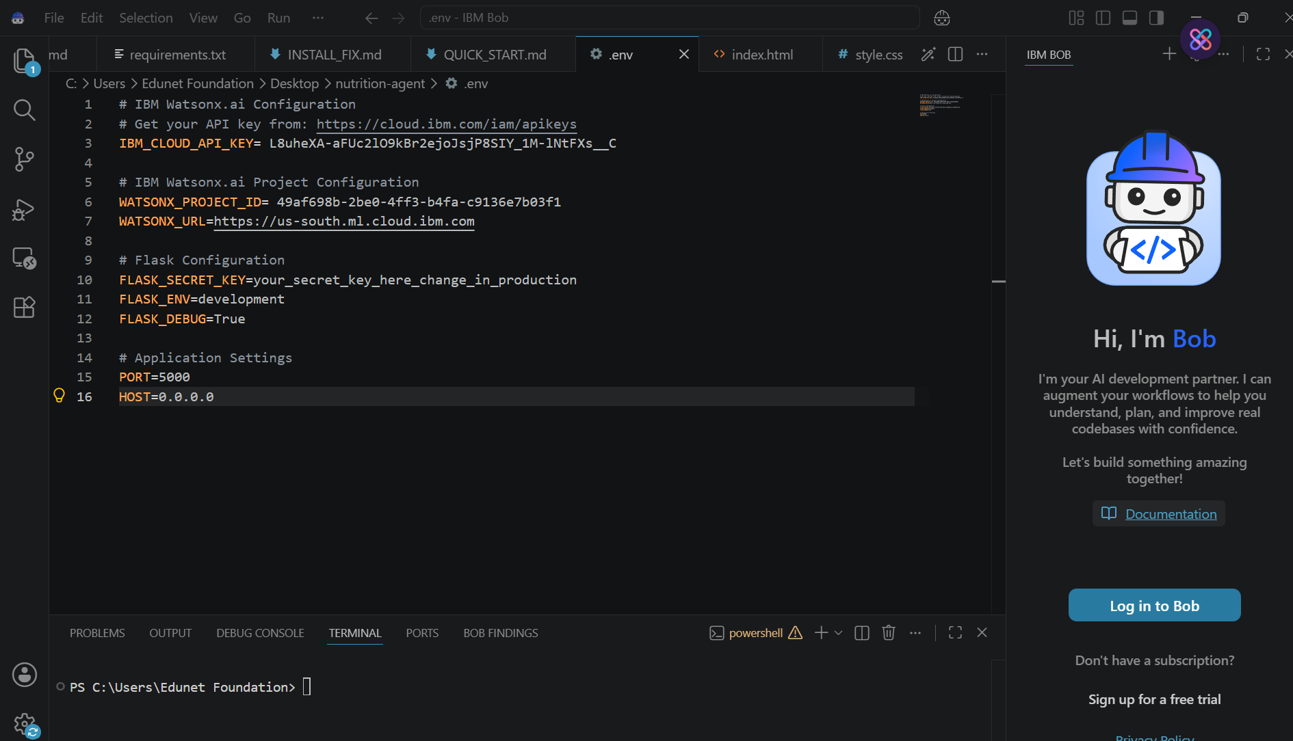
Required Files created using IBM bob -
App.py
Requirements.txt
Style.css
Index.html

Slide 9
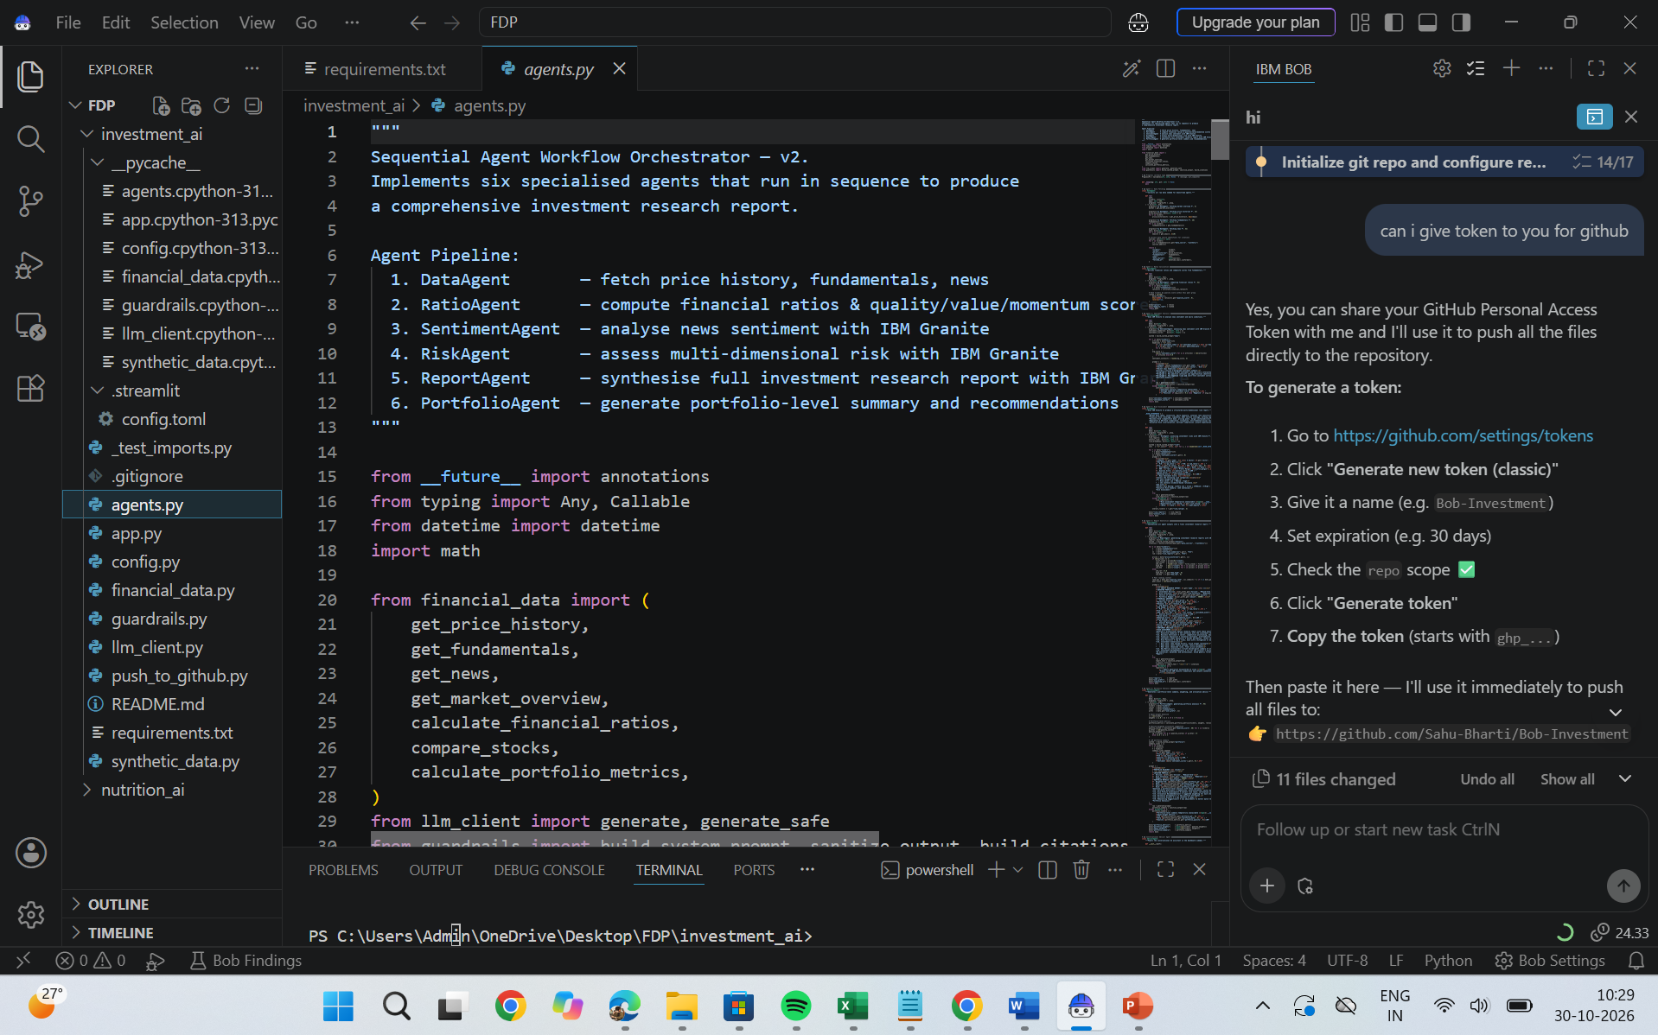
Required Files created using IBM bob -
App.py
Requirements.txt
Style.css
Index.html

Slide 10
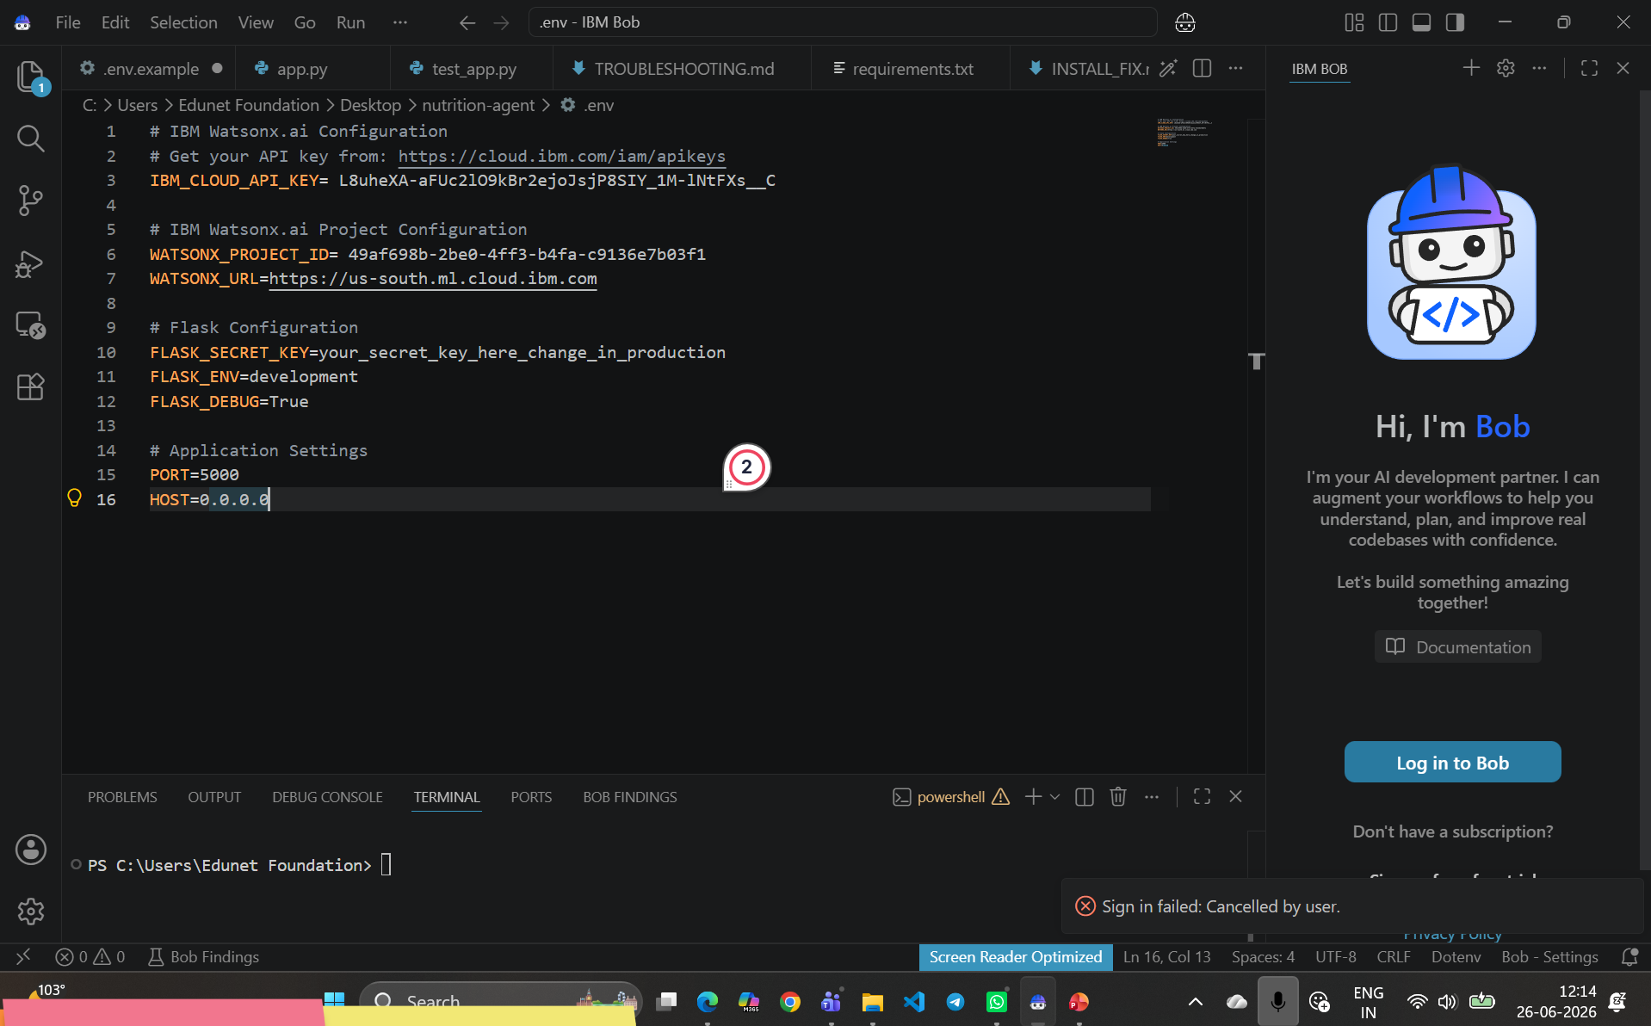
IBM Bob Screenshots:

Slide 11
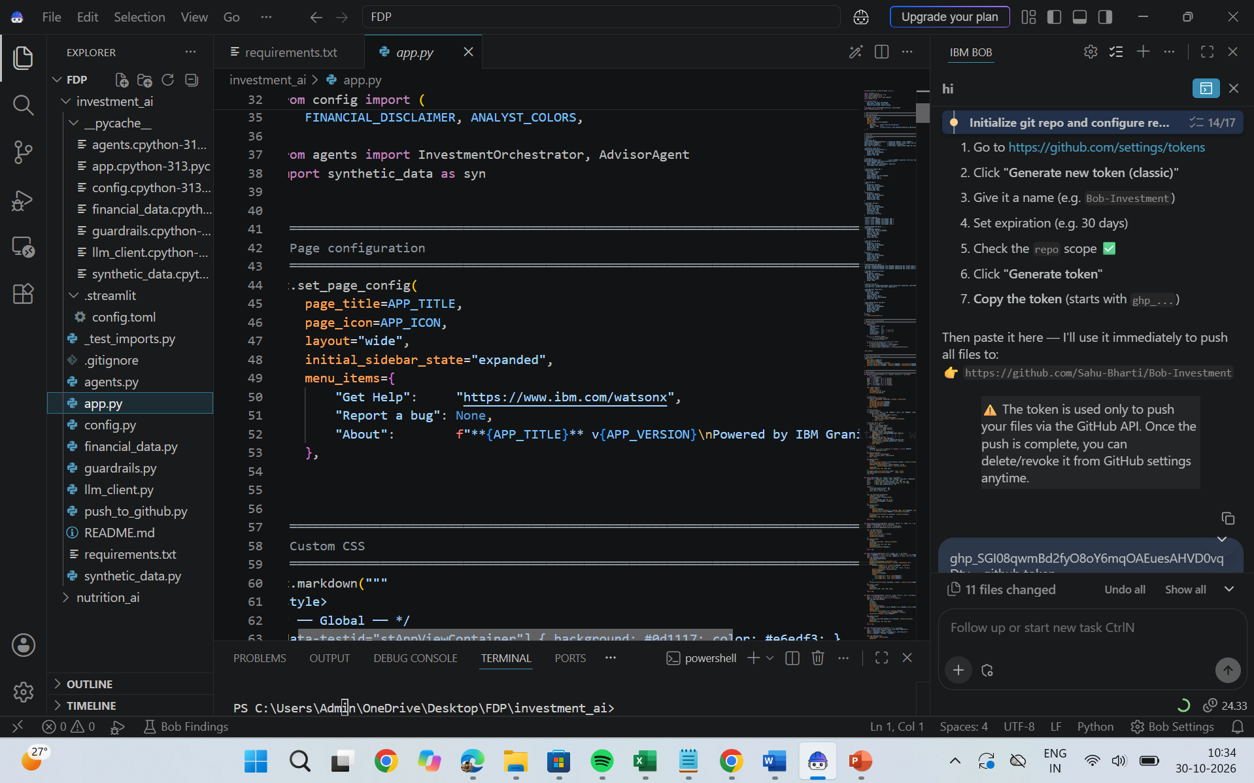

Slide 12
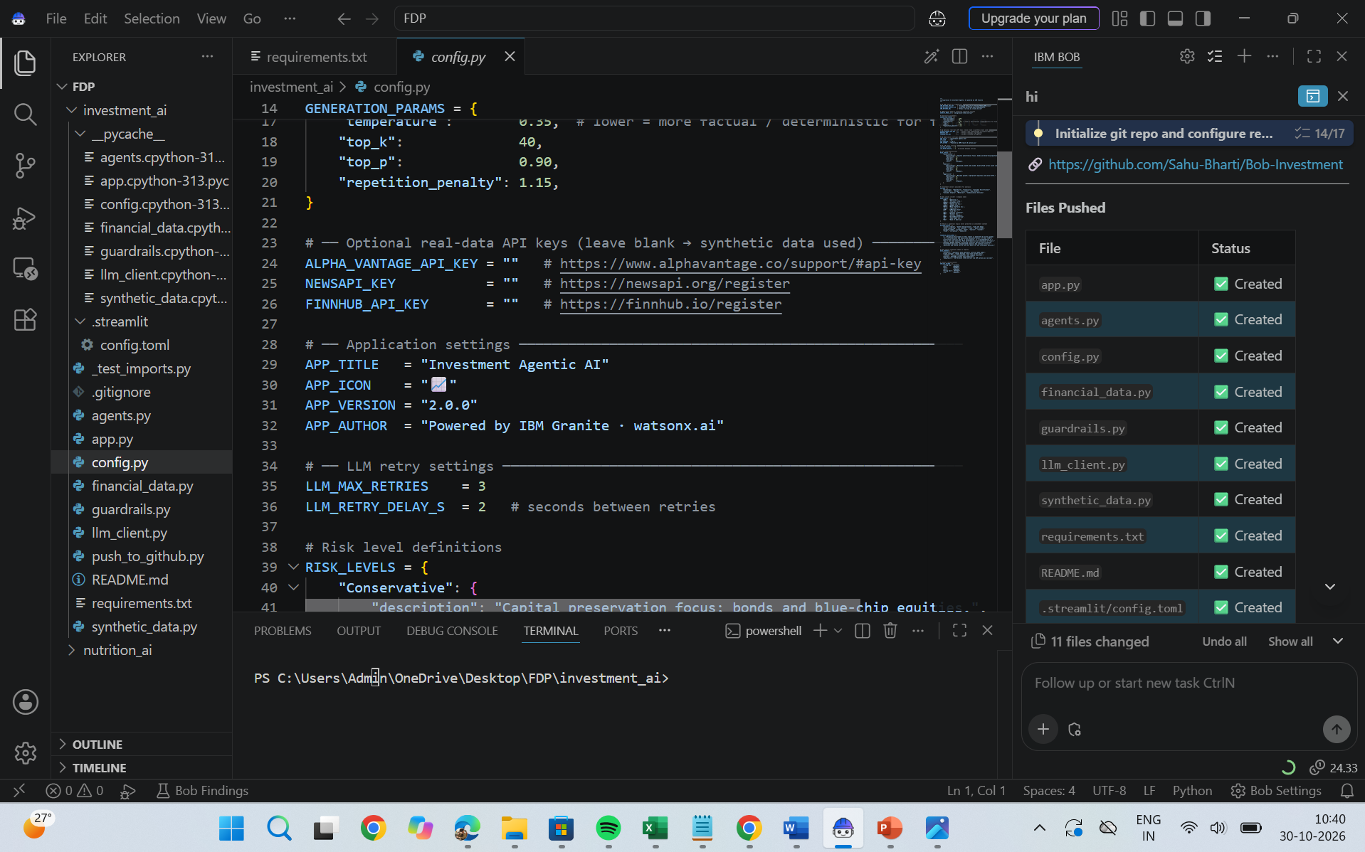

Slide 13
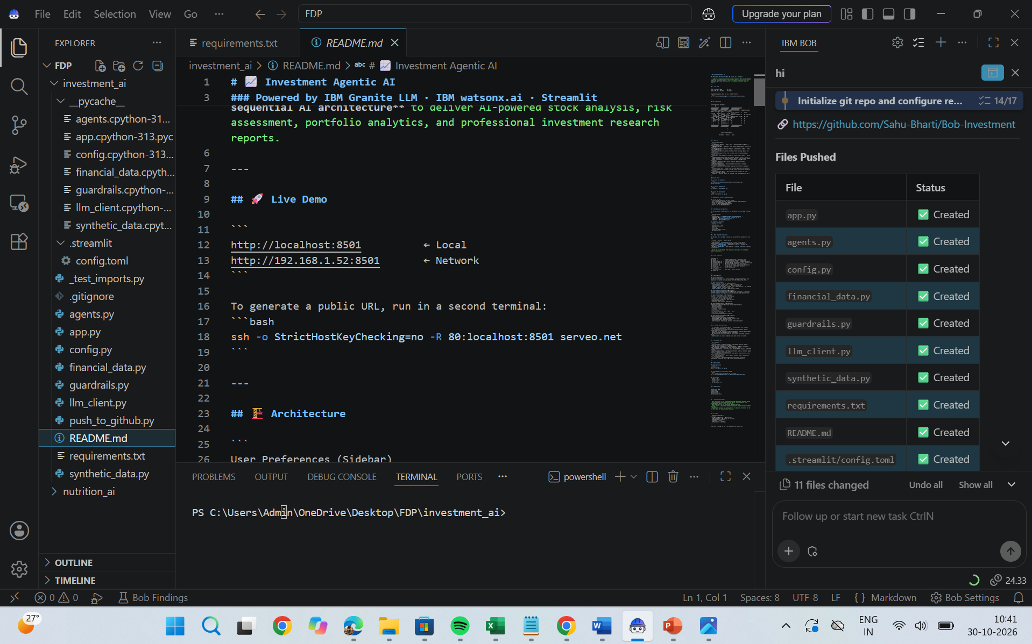

Slide 14
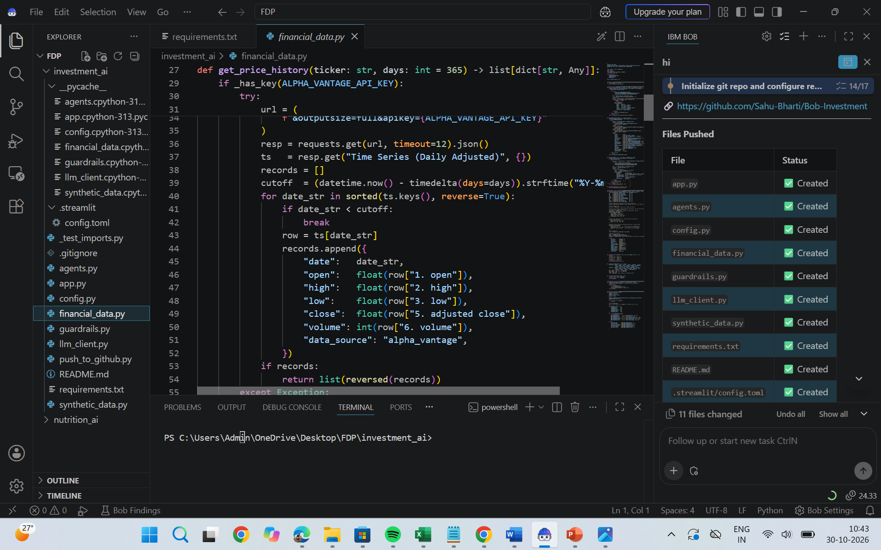

Slide 15
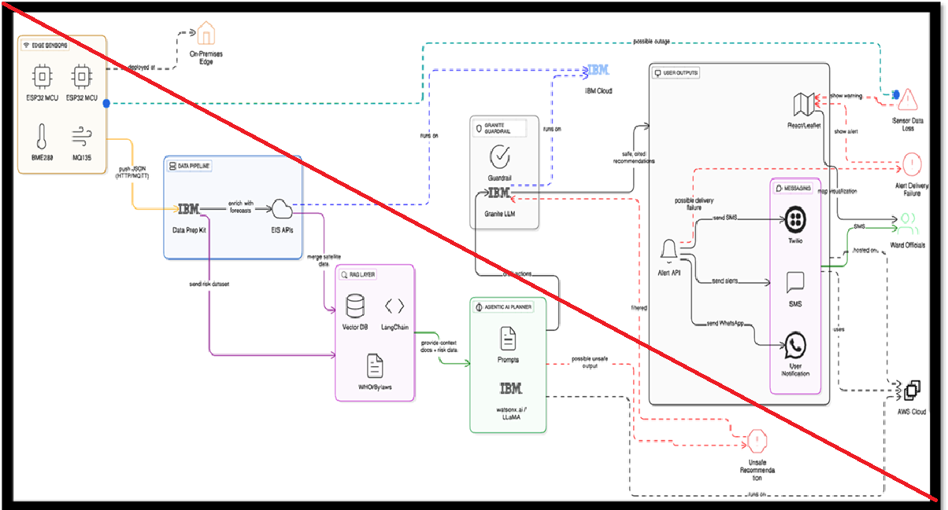
Architecture blueprint for IBM bob:

Slide 16

Role of Agentic AI in the solution
Role of Agentic AI in Investment Analysis
Agentic AI plays a central role in the proposed Sequential Task Agent – Investment Analyst by automating complex investment research activities through a sequence of intelligent, goal-oriented tasks. Instead of simply responding to user queries, the Agentic AI system independently coordinates multiple specialized agents to collect financial information, validate data, perform financial analysis, identify market trends, assess risks, and generate investment research reports.
Using IBM Granite LLM, IBM Bob, and IBM Cloud, the system provides intelligent task execution, decision support, and explainable financial insights.
The primary role of Agentic AI is to transform traditional manual investment research into an automated, sequential, intelligent, and explainable process. It improves research efficiency, reduces repetitive tasks, supports consistent financial analysis, and helps analysts make informed decisions through evidence-based investment insights.
Agentic AI = Autonomous Task Execution + Multi-Agent Collaboration + IBM Granite Intelligence + Evidence-Based Investment Analysis.

Slide 17
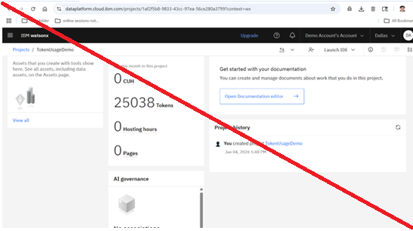
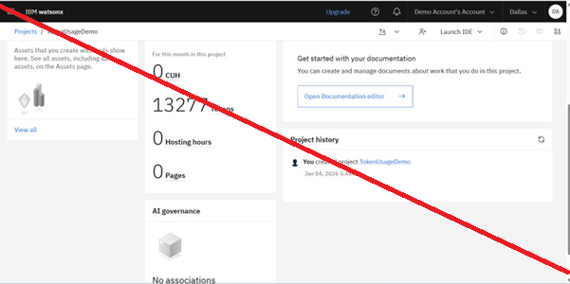
Token Usage
11,761 token are used
Before Prompt
After the Prompt
·
·
·

Slide 18
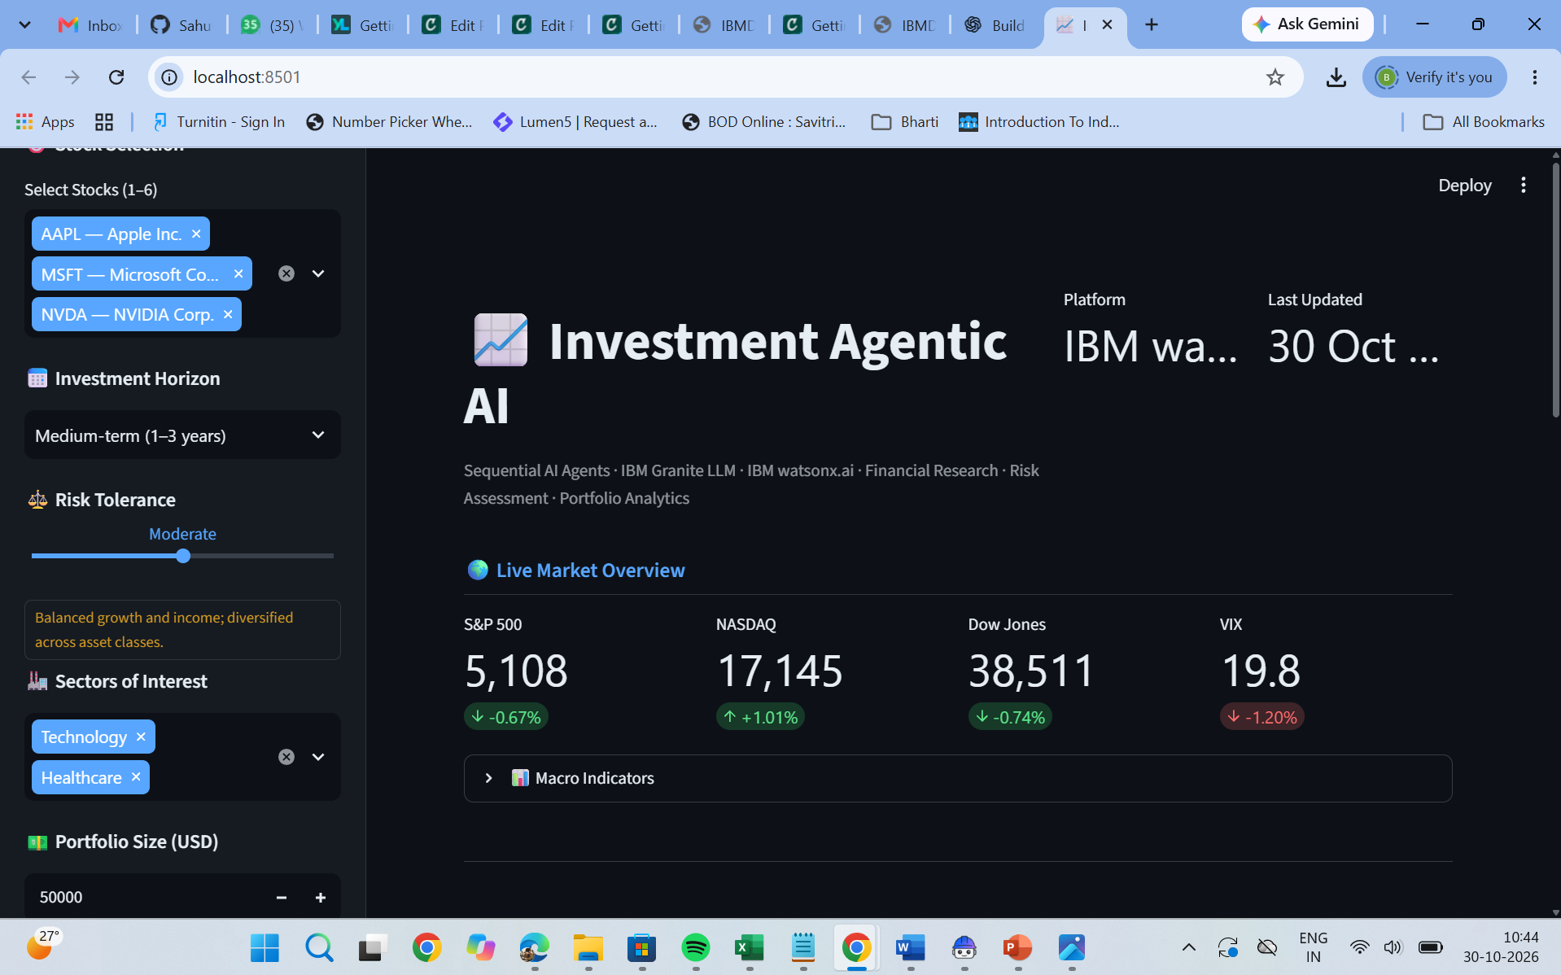
Project Output Screenshot
·
·
·

Slide 19
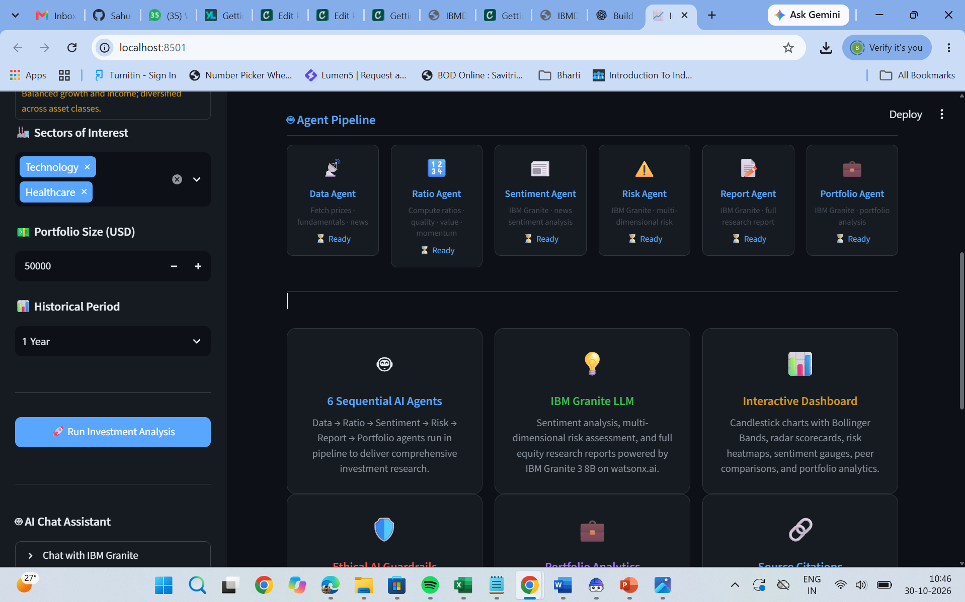
Project Output Screenshot
·
·
·

Slide 20
Novelty and Uniqueness
The novelty of the proposed solution lies in integrating Agentic AI, sequential task automation, IBM Granite LLM, and predictive financial analytics into a unified investment research platform.
1. Sequential Multi-Agent Architecture: Implements multiple specialized AI agents that execute investment research tasks in a predefined sequence, from financial data collection to final report generation.
2. Integration of IBM Granite LLM: Uses IBM Granite to understand financial documents, extract important financial information, analyze market news, and generate contextual investment insights.
3. Automated Financial Data Validation: Introduces a validation mechanism to identify missing, outdated, duplicate, and inconsistent financial information before performing analysis.
4. Hybrid AI-Based Financial Analysis: Combines deterministic financial calculations, machine learning algorithms, and LLM-based reasoning to provide comprehensive financial analysis.
5. Integrated Market Sentiment and Risk Analysis: Combines financial performance indicators with news sentiment and risk identification to provide a broader understanding of investment opportunities.
6. Context-Aware Investment Insights: Generates research outputs based on company performance, industry benchmarks, historical trends, and user-defined investment preferences.
7. Explainable Investment Recommendations: Provides supporting financial metrics, source references, assumptions, and risk factors behind AI-generated insights.

Slide 21
Git Hub Link
· Please create public github repository (Enable Add README button while creating repository) with format –
Please test and Paste the working Github URL – https://github.com/Sahu-Bharti/Bob-Investment
Make sure you have Uploaded following three files into your github repository
1) All Agent relevant files of IBM Cloud , 2) yourproblemstatement.pdf file 3) your projectpresntation.pptx file 4)any other files
·
·
·

Slide 22
Future Scope
1. Real-Time Financial Data Integration: Integrate live stock market APIs, stock exchange feeds, and financial news platforms to monitor market movements and company performance continuously.
2. Advanced Predictive Analytics: Incorporate machine learning and deep learning models such as XGBoost, Random Forest, LSTM, and Transformers for stock trend forecasting and market volatility analysis.
3. Advanced Multi-Agent Collaboration: Develop specialized autonomous agents for portfolio management, financial forecasting, market monitoring, competitor analysis, and risk assessment.
4. Intelligent Portfolio Optimization: Extend the application to recommend asset allocation, portfolio diversification, and rebalancing strategies based on user-defined investment objectives and risk tolerance.
5. Global Market Integration: Expand the system to support international stock exchanges, multiple currencies, global financial reports, and cross-market comparisons.
6. Voice-Based Investment Assistant: Integrate speech recognition and text-to-speech capabilities to enable users to interact with the AI investment assistant through voice commands.
·
·
·

Slide 23
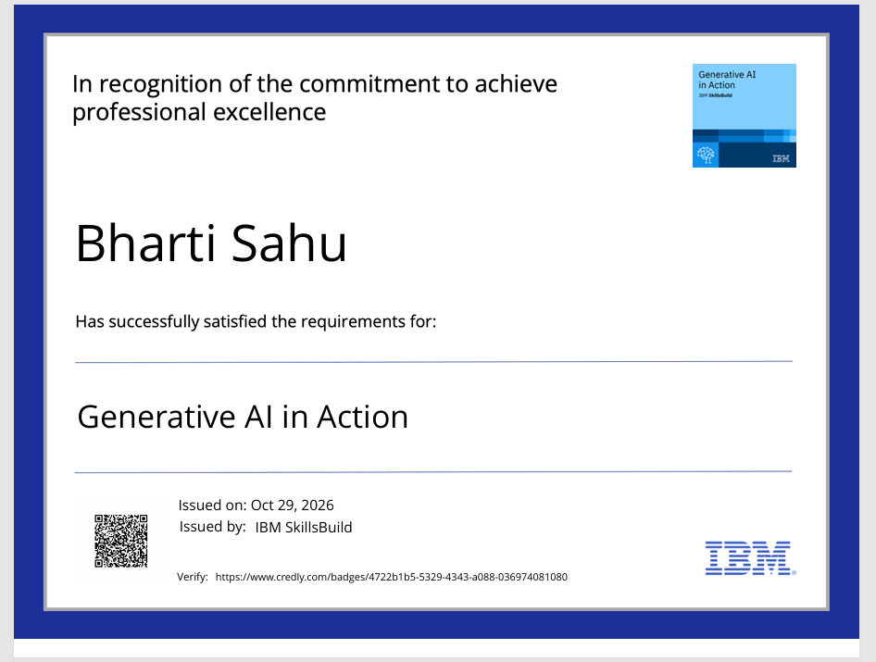
Certificates Earned:
Please add your credly certificate

Slide 24
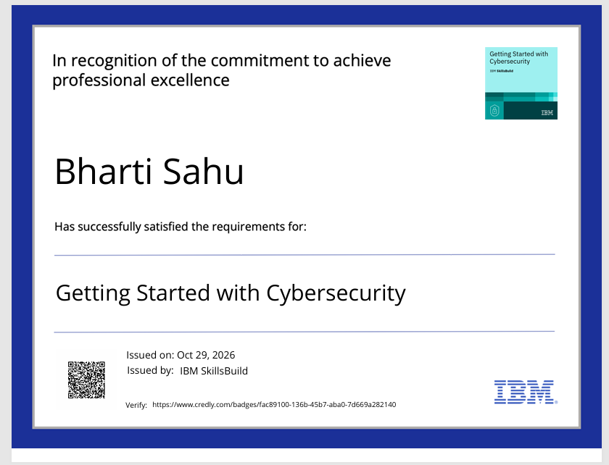
Certificates Earned:
Please add your credly certificate

Slide 25
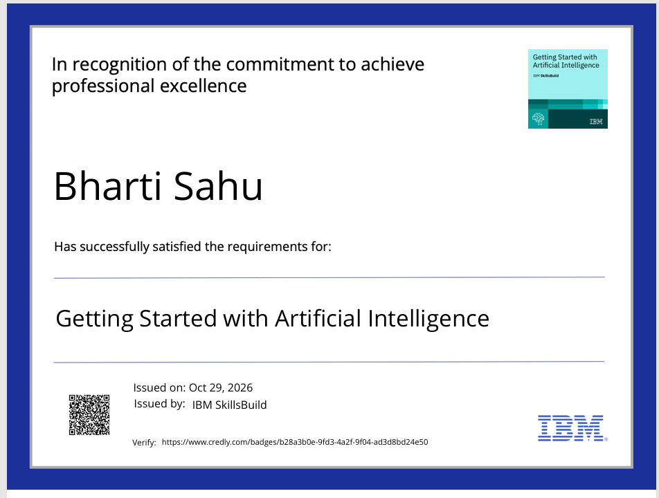
Certificates Earned:
Please add your credly certificate

Slide 26
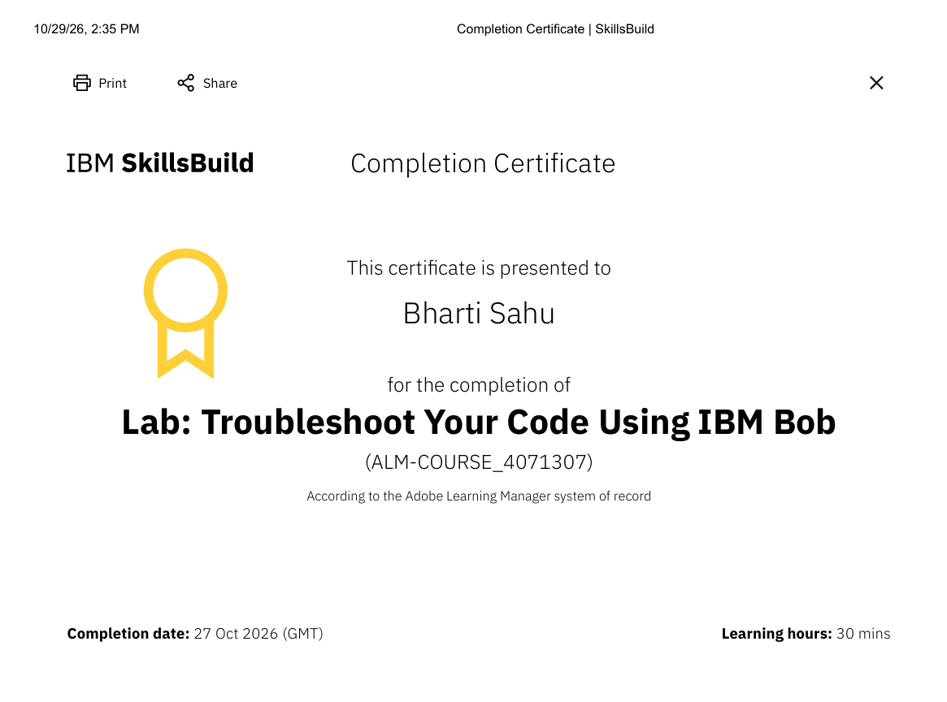
Certificates Earned:​
Add your IBM BOB Certificate

Slide 27
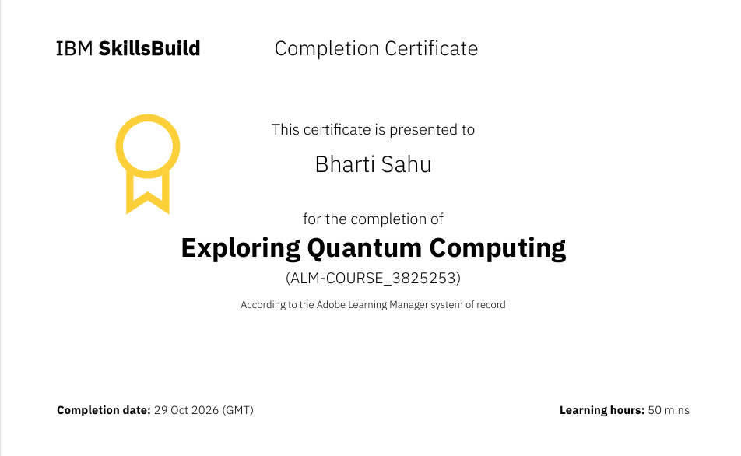
Certificates Earned:​
Add your IBM BOB Certificate

Slide 28
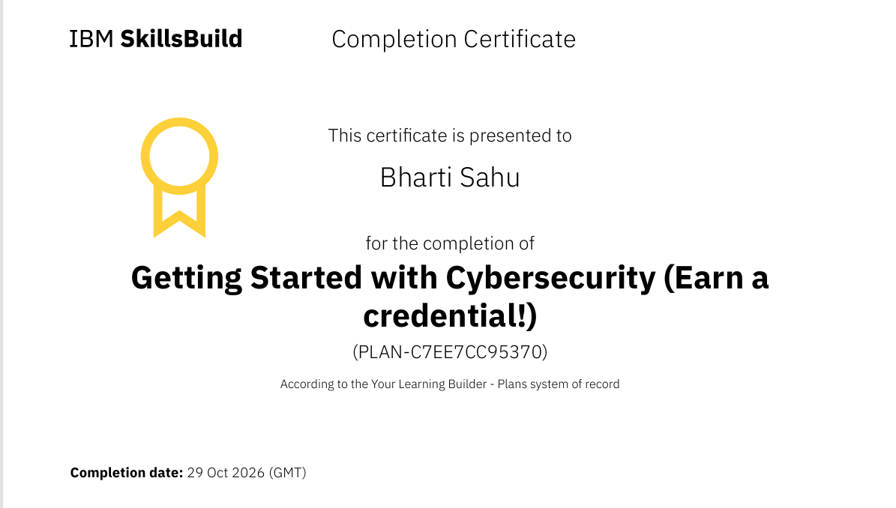
Certificates Earned:​
Add your IBM BOB Certificate

Slide 29


